Slide 1


Andres D. Espada
14-06-2025

Slide 2

Outline
Executive Summary
Introduction
Methodology
Results
Conclusion
Appendix

Slide 3
Executive Summary
SpaceX has revolutionized satellite launches through its reusable booster concept, significantly reducing costs per kilogram compared to traditional launch vehicles like Soyuz or Ariane 5.
Key Features of Falcon 9's Reusability:
Cost Efficiency: The primary advantage is dramatically lower launch costs.
Mission Success Criteria: For SpaceX, a successful mission includes not only payload delivery but also booster recovery.
Recovery Dependencies: Successful booster landing depends on multiple factors, including:
Orbit type
Payload mass
Booster version
Launch site
Challenges and Reliability:
Despite its cost benefits, Falcon 9 still faces reliability challenges when compared to conventional launchers.
Machine Learning for Recovery Prediction:
Using supervised classification models, this report analyzes booster recovery outcomes. The best-performing model achieved 94% accuracy in predicting landing success based on critical mission parameters.

Slide 4
Introduction
Falcon 9 launches cost ~$62M vs competitors ~$165M, mainly due to first-stage reuse.
Predicting first-stage landing feasibility helps estimate launch cost and informs competitive bids.
This study develops a model to forecast Falcon 9 booster landing success using historical launch data.

Slide 5

Section 1

Slide 6
Methodology
Executive Summary
Data collection methodology:
Perform data wrangling
Perform exploratory data analysis (EDA) using visualization and SQL
Perform interactive visual analytics using Folium and Plotly Dash
Perform predictive analysis using classification model

Slide 7
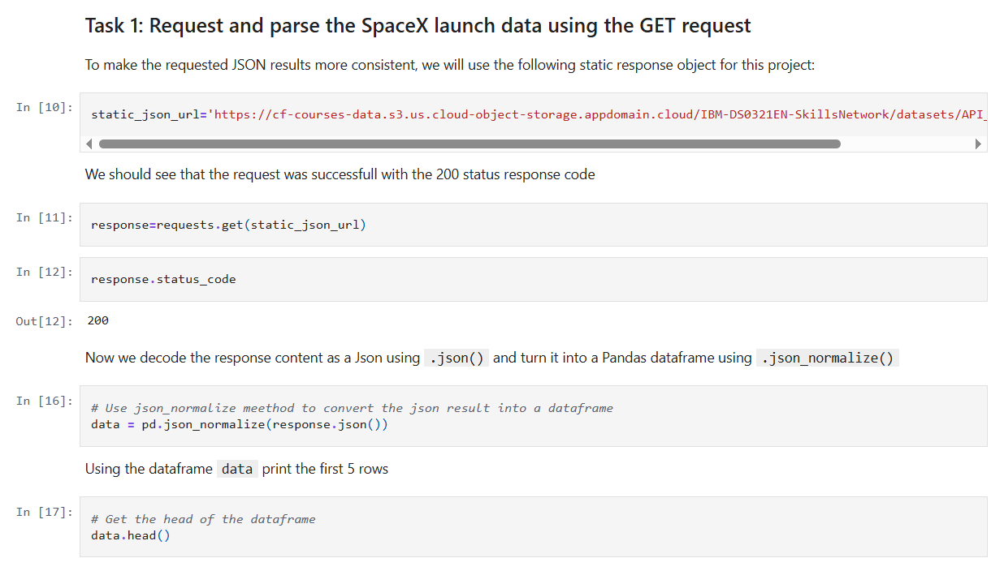
Data Collection – SpaceX API
Launch data were collected from the SpaceX REST API via GET requests; the JSON responses were parsed and loaded into a Pandas DataFrame.
GitHub URL of the completed SpaceX API calls notebook: https://github.com/adespada/project-capstone/blob/main/jupyter-labs-spacex-data-collection-api%20(1).ipynb

Slide 8
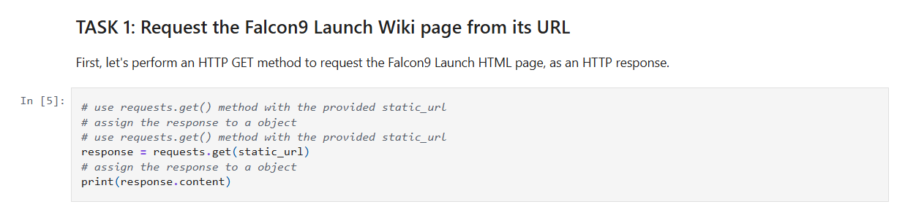
Data Collection - Scraping
Historical Falcon 9 launch records were obtained by scraping the relevant Wikipedia page using requests and BeautifulSoup; the HTML table was parsed and loaded into a Pandas DataFrame.
GitHub URL: https://github.com/adespada/project-capstone/blob/main/jupyter-labs-webscraping%20(1).ipynb

Slide 9
Data Wrangling
The data were loaded into a Pandas DataFrame and filtered by the Booster Version column to retain only Falcon 9 launches. Missing values in the Payload Mass column were imputed using the column’s mean.
GitHub URL: https://github.com/adespada/project-capstone/blob/main/labs-jupyter-spacex-Data%20wrangling.ipynb

Slide 10
EDA with Data Visualization
Exploratory data analysis and feature engineering were performed using Pandas and Matplotlib, including:
Conducting initial data exploration and preparing features.
Creating scatter plots to examine relationships between flight number and launch site, payload and launch site, flight number and orbit type, and payload and orbit type.
Generating bar charts to show success rates for each orbit category.
Plotting a line chart to illustrate the annual trend in launch success
GitHub URL: https://github.com/adespada/project-capstone/blob/main/edadataviz.ipynb

Slide 11
EDA with SQL
The following SQL queries were performed for EDA:
Display the names of the unique launch sites in the space mission.
%sql SELECT Unique(LAUNCH_SITE) FROM SPACEXTBL;
Display 5 records where launch sites begin with the string 'CCA’.
%sql SELECT LAUNCH_SITE FROM SPACEXTBL WHERE LAUNCH_SITE LIKE 'CCA%' LIMIT 5;
Display the total payload mass carried by boosters launched by NASA (CRS).
%sql SELECT SUM(PAYLOAD_MASS__KG_) AS payload mass FROM SPACEXTBL;
Display average payload mass carried by booster version F9 v1.1
%sql SELECT AVG(PAYLOAD_MASS__KG_) AS payload mass FROM SPACEXTBL;
List the date when the first successful landing outcome in ground pad was achieved.%sql SELECT MIN(DATE) FROM SPACEXTBL;

Slide 12
EDA with SQL
List the names of the boosters which have success in drone ship and have payload mass greater than 4000 but less than 6000.%sql select BOOSTER_VERSION from SPACEXTBL where LANDING_OUTCOME='Success (drone ship)' and PAYLOAD_MASS__KG_ between 4000 and 6000
List the total number of successful and failure mission outcomes%sql select count(MISSION_OUTCOME) as mission outcomes from SPACEXTBL group by MISSION_OUTCOME
List the names of the booster versions which have carried the maximum payload mass. Use a subquery%sql select BOOSTER_VERSION as booster version from SPACEXTBL where PAYLOAD_MASS__KG_ = (select max(PAYLOAD_MASS__KG_) from SPACEXTBL)
GitHub URL: https://github.com/adespada/project-capstone/blob/main/jupyter-labs-eda-sql-coursera_sqllite.ipynb

Slide 13
Build an Interactive Map with Folium
A map was created using the Folium library to mark all launch sites, with elements such as markers, circles, and lines indicating each launch’s outcome, where failures are coded as 0 and successes as 1.
GitHub URL: https://github.com/adespada/project-capstone/blob/main/lab_jupyter_launch_site_location%20(1).ipynb

Slide 14
Build a Dashboard with Plotly Dash
Developed an interactive dashboard in Plotly Dash by:
Adding a dropdown component for selecting the launch site.
Implementing a callback to render a success-rate pie chart based on the chosen site.
Including a range slider to filter by payload mass.
Implementing a callback to display a scatter plot of payload versus launch outcome.
GitHub URL: https://github.com/adespada/project-capstone/blob/main/spacex-dash-app.py

Slide 15
Predictive Analysis (Classification)
Load and explore the data in a Pandas DataFrame, extract the target (“Class”) into `Y`, standardize features with `StandardScaler`, and split into train/test (80/20, random\_state=2). For each candidate algorithm (SVM, Decision Tree, KNN, Logistic Regression), use `GridSearchCV` with 10-fold cross-validation to tune hyperparameters and record the best settings and validation accuracy. Finally, evaluate each tuned model on the test set (compute accuracy and inspect the confusion matrix) and compare results to select the best-performing classifier for predicting booster recovery.
GitHub: https://github.com/adespada/project-capstone/blob/main/SpaceX_Machine%20Learning%20Prediction_Part_5.ipynb

Slide 16
Results
Exploratory data analysis results
Interactive analytics demo in screenshots
Predictive analysis results

Slide 17

Section 2

Slide 18
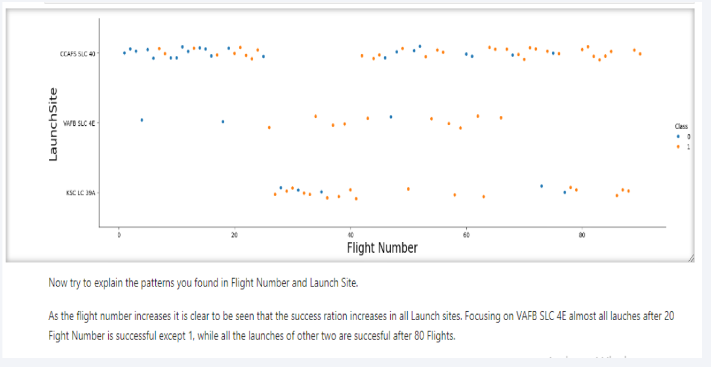
Flight Number vs. Launch Site

Slide 19
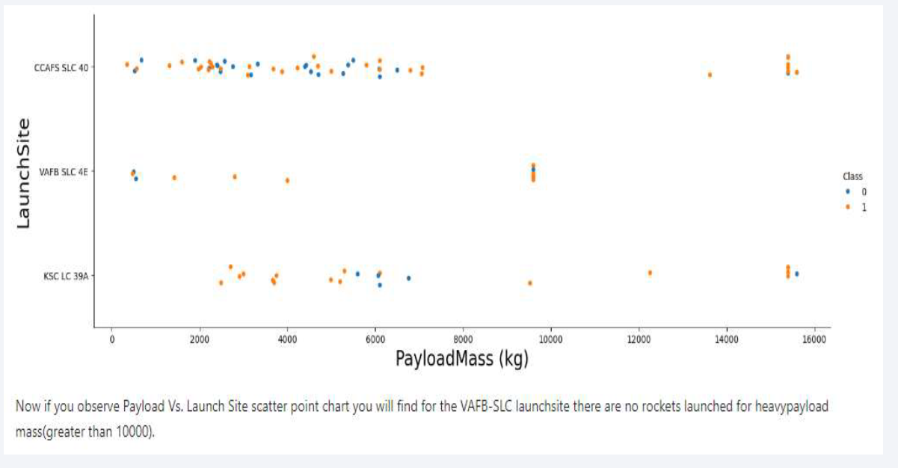
Payload vs. Launch Site

Slide 20
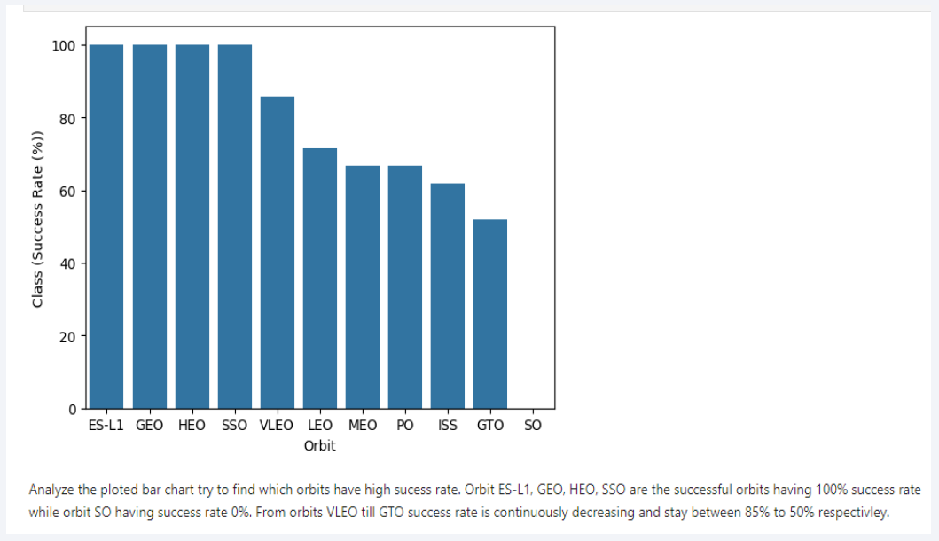
Success Rate vs. Orbit Type

Slide 21
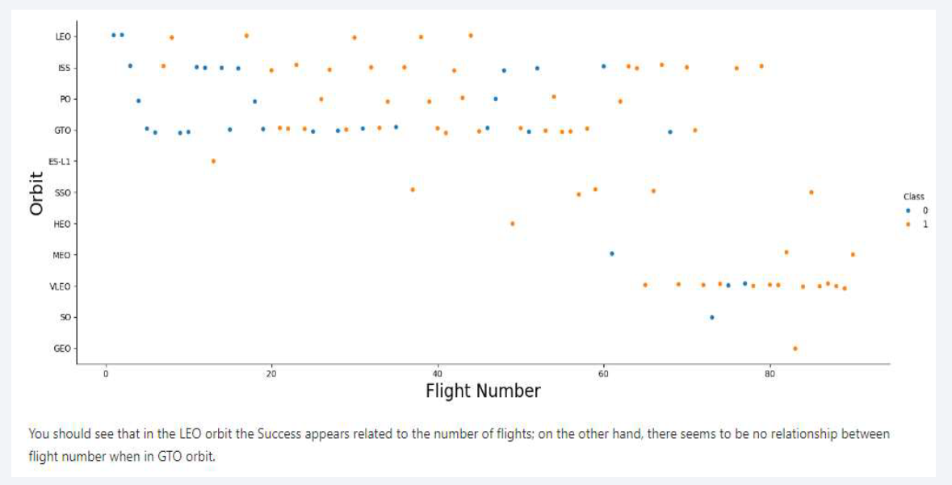
Flight Number vs. Orbit Type

Slide 22
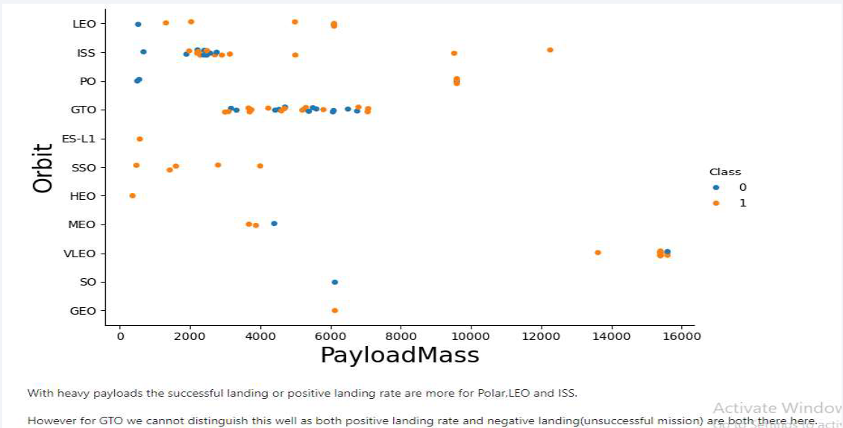
Payload vs. Orbit Type

Slide 23
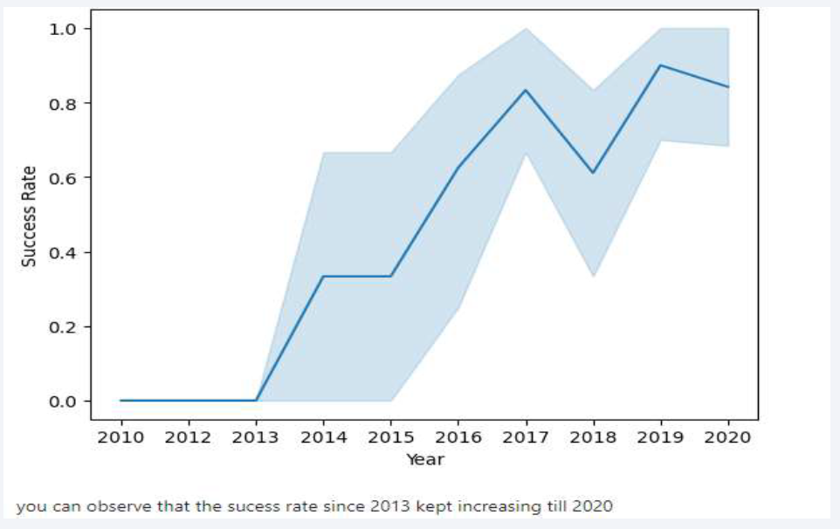
Launch Success Yearly Trend

Slide 24
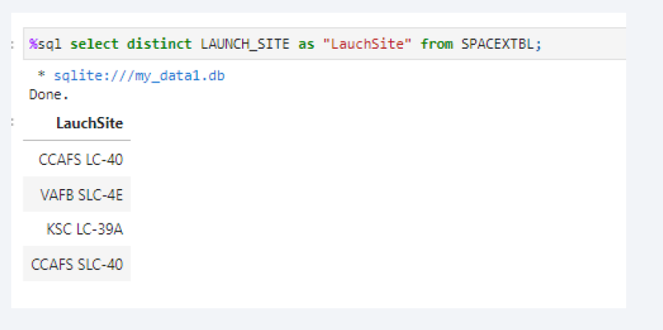
All Launch Site Names
All launch sites are taking as a list called launch site. Using distinct we get all the unique different sites used in launching.

Slide 25
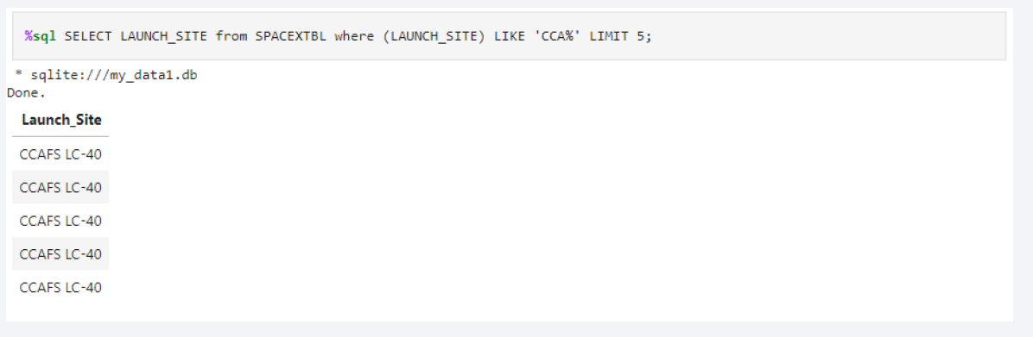
Launch Site Names Begin with 'CCA'
This is the list of launch site specifically starts with CCA with the of LIKE query and using LIMIT query to get only top 5 results.

Slide 26
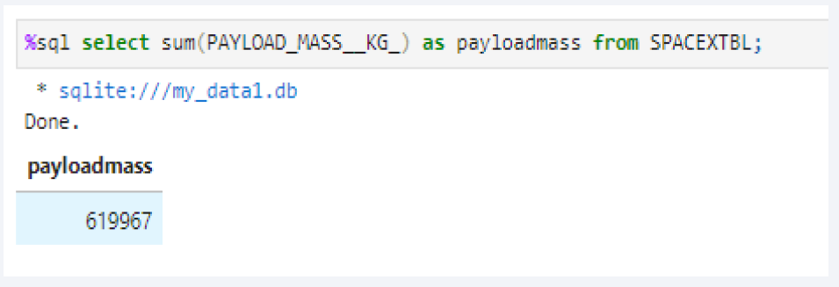
Total Payload Mass
Using SUM query can make the total of all payload mass from Payload_Mass_Kg

Slide 27
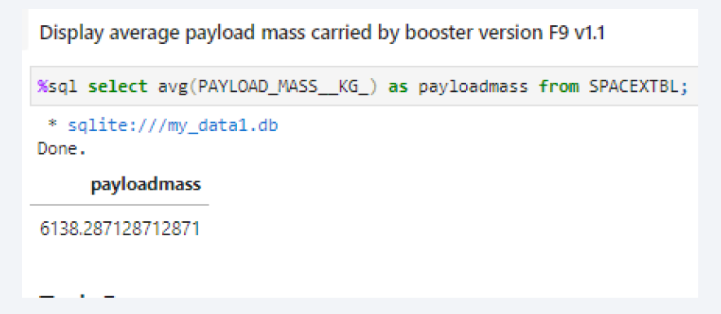
Average Payload Mass by F9 v1.1
The average payloadmass can be find by using AVG on the column of payload_mass_kg

Slide 28
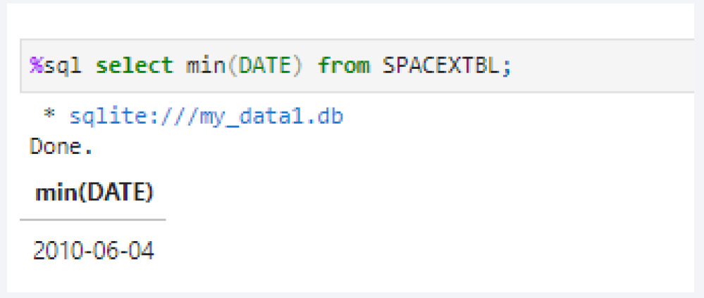
First Successful Ground Landing Date
This is the .first date of a successful landing outcome by using MIN on the date column

Slide 29
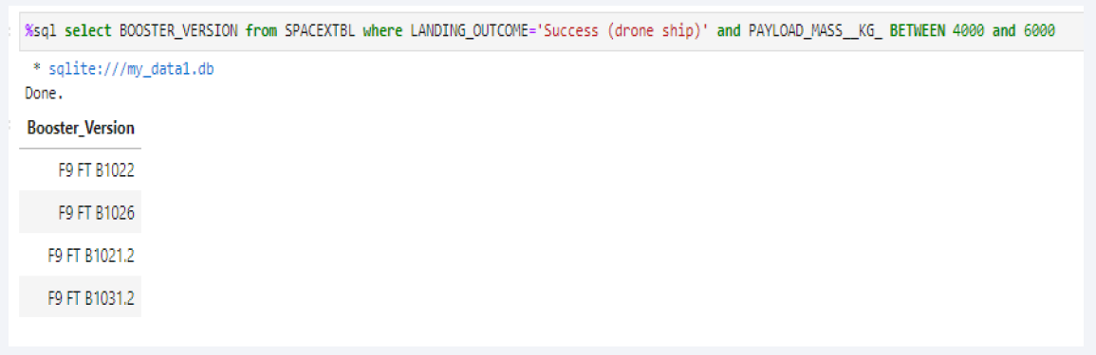
Successful Drone Ship Landing with Payload between 4000 and 6000
This is the list from BOOSTER Version column and applying two conditions on them:
Landing outcome must be on drone ship and should be successful.
Payload mass kg should be between 4000 to 6000. AND statement shows that all conditions must be fulfilled.

Slide 30
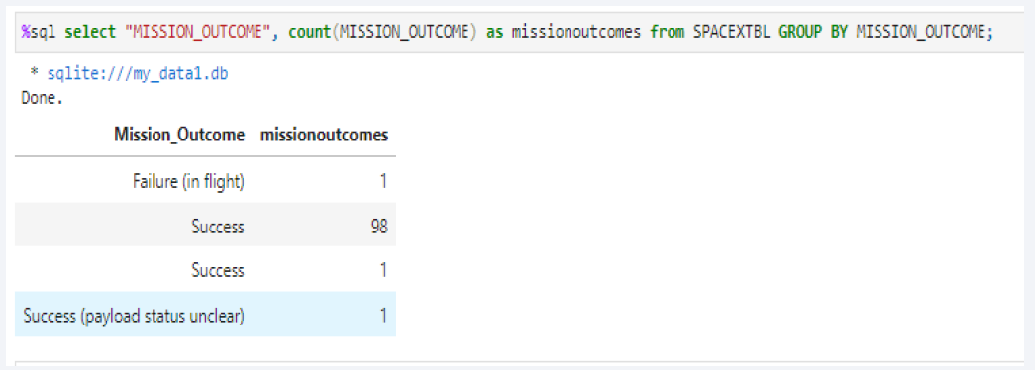
Total Number of Successful and Failure Mission Outcomes
Used the COUNT together with the GROUP BY statement to return total number of missions outcomes.

Slide 31
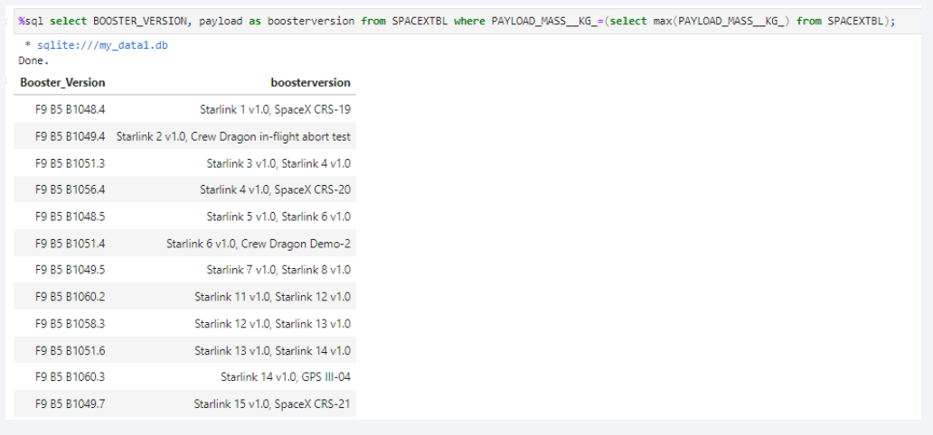
Boosters Carried Maximum Payload
Using a Subquerry to return and pass the Max payload and used it list all the boosters that have carried the Max payload of 15600kgs.

Slide 32
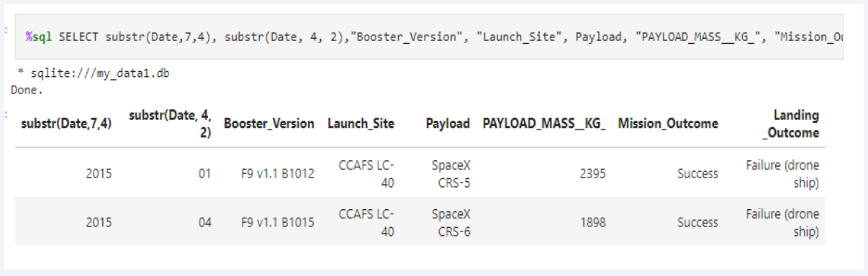
2015 Launch Records
Used the subsrt in the select statement to get the month and year from the date column where substr (Date,7,4)='2015' for year and Landing_outcome was ‘Failure (drone ship) and return the records nmatching the filter

Slide 33
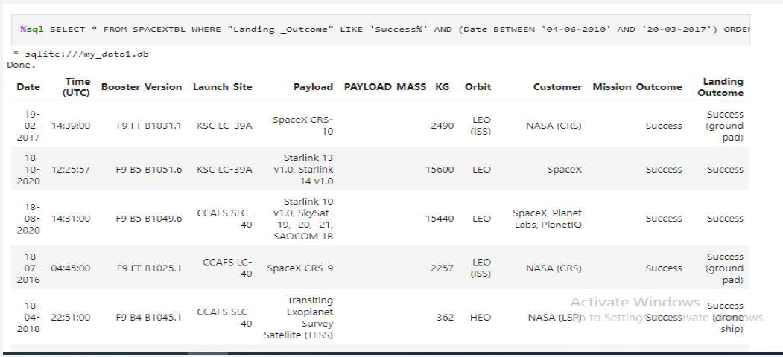
Rank Landing Outcomes Between 2010-06-04 and 2017-03-20
Rank the count of landing outcomes (such as Failure (drone ship) or Success (ground pad)) between the date 2010 06 04 and 2017 03 20, in descending order using DESC statement.

Slide 34

Section 3

Slide 35
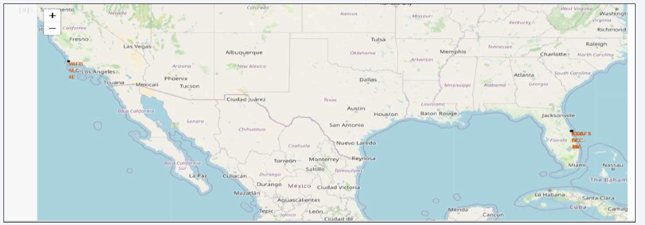
Folium Map
There are total 4 launch sites of SpaceX
VAFB SLC 4E: Vandenberg Space Launch Complex 4 (CA)
KSC LC29A: Kennedy Space Center Merritt Island (FL)
CCAFS LC40: Cape Canaveral Launch Complex 40 (FL)
CCAF SLC40: Cape Canaveral Space Launch Complex 40(FL)

Slide 36
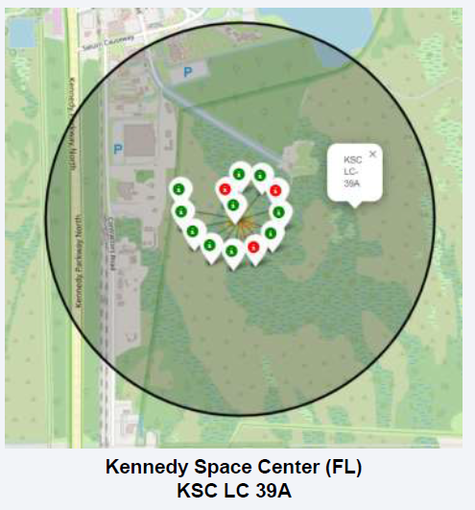
Folium Map launch sites
These are the successful and unsuccessful launch sites. Green shows successful launch while red are unsuccessful launches.
The KSC LC 39A have mostly successful launches which is 10 successful while 3 unsuccessful.

Slide 37
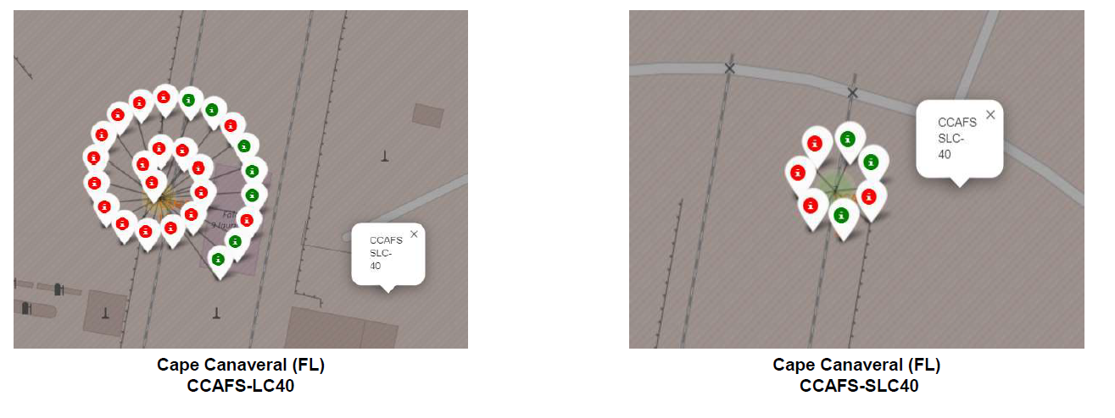
Folium Map successful launches
Launch site CCAFS SLC 40 have two launch site close to each other.
The first site have 26 launches out of which only 7 were successful while the other left representation shows total 7 launches out of which only 3 were successful.
In general it is clear that the launches from this area are mostly unsuccessful.

Slide 38

Section 4

Slide 39
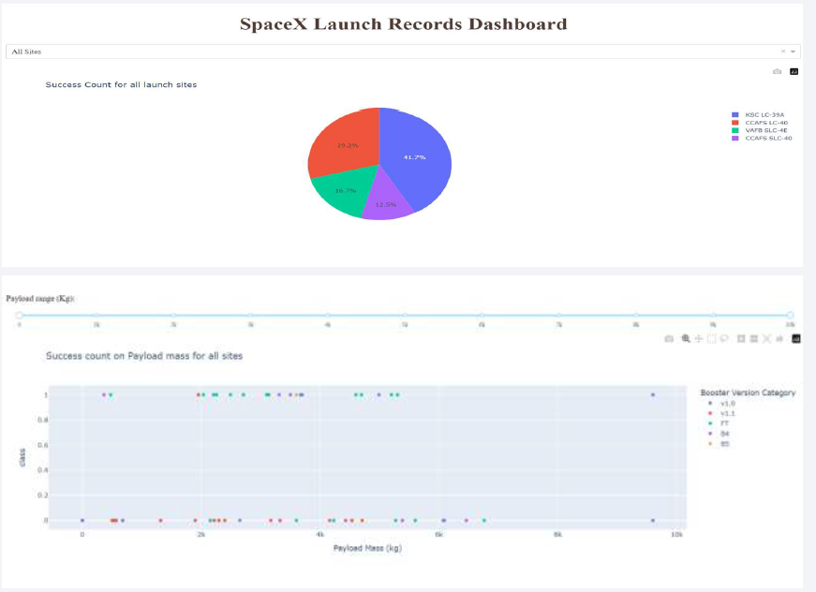
Dashboard
We developed an interactive Plotly dashboard that includes:
A dropdown menu for selecting launch sites.
Pie charts showing launch success rates.
A scatter plot illustrating launch site, payload mass, and outcome (success vs. failure).
A range slider to filter by payload mass (in kg).

Slide 40
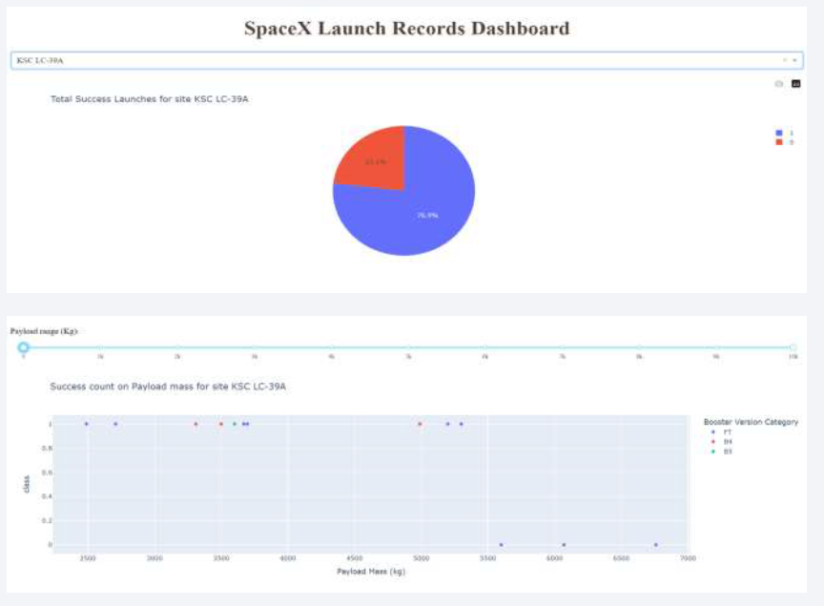
Plotly
By analyzing the data, we identified:
The launch site with the greatest number of successful missions.
The launch site with the highest overall success rate.
Payload mass range(s) associated with the highest launch success rate.
Payload mass range(s) associated with the lowest launch success rate.
Falcon 9 booster version(s) (e.g., v1.0, v1.1, FT, Block 4, Block 5) with the highest success rates.

Slide 41
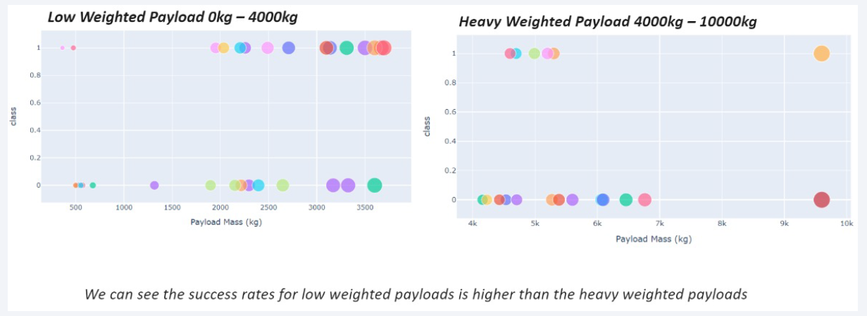
Scatter plot of Payload vs Launch Outcome

Slide 42

Section 5

Slide 43
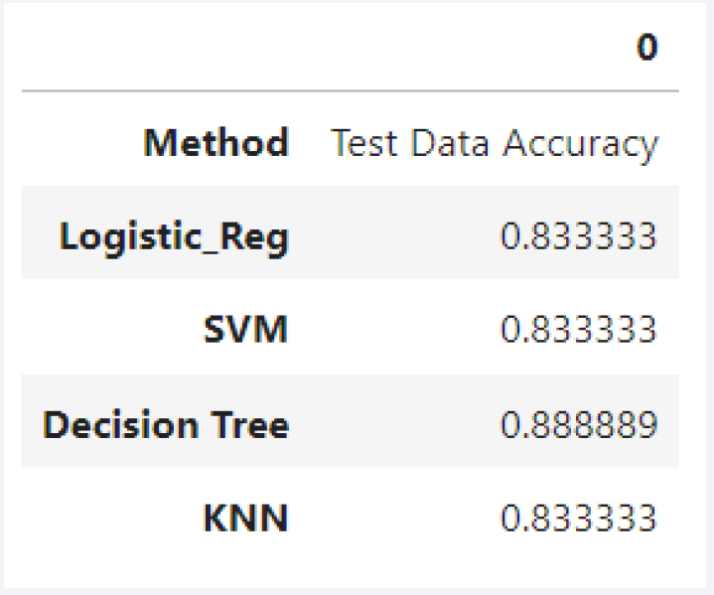
Classification Accuracy
The decision tree classifier is the model with the highest classification accuracy

Slide 44
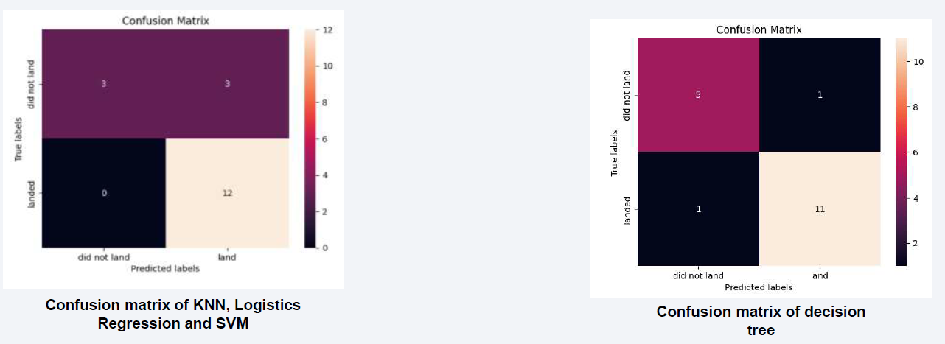
Confusion Matrix
Decision Tree is the model predicted more accuracy than other three.
Other predicted about unsuccessful landings were 100% correct while decision tree prediction about successful landing is more accurate than others.

Slide 45
Conclusions
Different launch sites exhibit varying success rates. For example, CCAFS LC-40 has a success rate of 60%, whereas KSC LC-39A and VAFB SLC-4E each show a 77% success rate. Moreover, success tends to improve as flight numbers increase at these sites: VAFB SLC-4E achieves a 100% success rate after its 50th flight, while both KSC LC-39A and CCAFS SLC-40 reach 100% success after their 80th flight.
Examining the Payload vs. Launch Site scatter plot reveals that VAFB SLC-4E has not launched rockets carrying very heavy payloads (above 10,000 kg).Orbit-specific success rates also vary significantly:
ES-L1, GEO, HEO, and SSO orbits all have achieved 100% success.
The SO orbit has the lowest success rate, with no successful recoveries recorded (0%).
For LEO launches, there appears to be a positive correlation between flight number and success rate—later flights are more likely to succeed. In contrast, for GTO missions, there is no clear relationship between the flight number and launch success.

Slide 46


